Slide 1
Advanced Transaction Processing
Transaction-Processing Monitors
Transactional Workflows

Slide 2
Transaction Processing Monitors
TP monitors initially developed as multithreaded servers to support large numbers of terminals from a single process.
Provide infrastructure for building and administering complex transaction processing systems with a large number of clients and multiple servers.
Provide services such as:
  Presentation facilities to simplify creating user interfaces
  Persistent queuing of client requests and server responses
  Routing of client messages to servers
  Coordination of two-phase commit when transactions access multiple servers.
Some commercial TP monitors: CICS from IBM, Pathway from Tandem, Top End from NCR, and Encina from Transarc

Slide 3
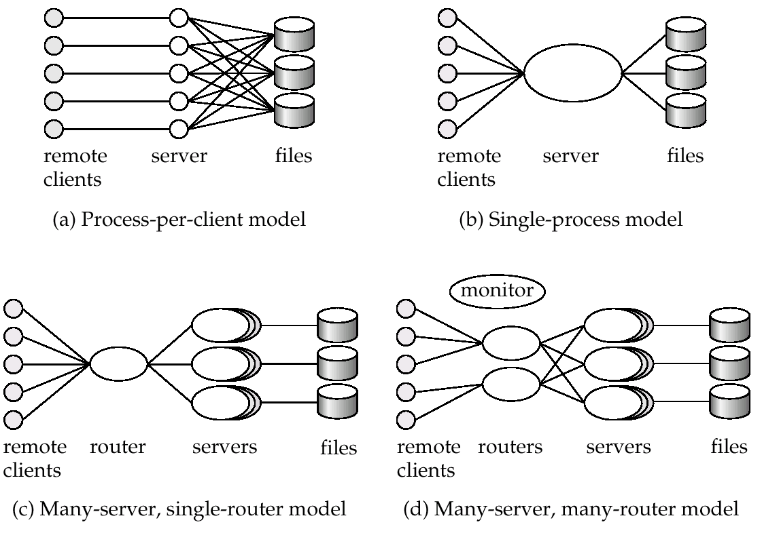
TP Monitor Architectures

Slide 4
TP Monitor Architectures (Cont.)
Process per client model - instead of individual login session per terminal, server process communicates with the terminal, handles authentication, and executes actions.
  Memory requirements are high
  Multitasking- high CPU overhead for context switching between processes
Single process model - all remote terminals connect to a single server process.
  Used in client-server environments
  Server process is multi-threaded; low cost for thread switching
  No protection between applications
  Not suited for parallel or distributed databases

Slide 5
TP Monitor Architectures (Cont.)
Many-server single-router model - multiple application server processes access a common database; clients communicate with the application through a single communication process that routes requests.
  Independent server processes for multiple applications
  Multithread server process
  Run on parallel or distributed database
Many server many-router model - multiple processes communicate with clients.
  Client communication processes interact with router processes that route their requests to the appropriate server.
  Controller process starts up and supervises other processes.

Slide 6
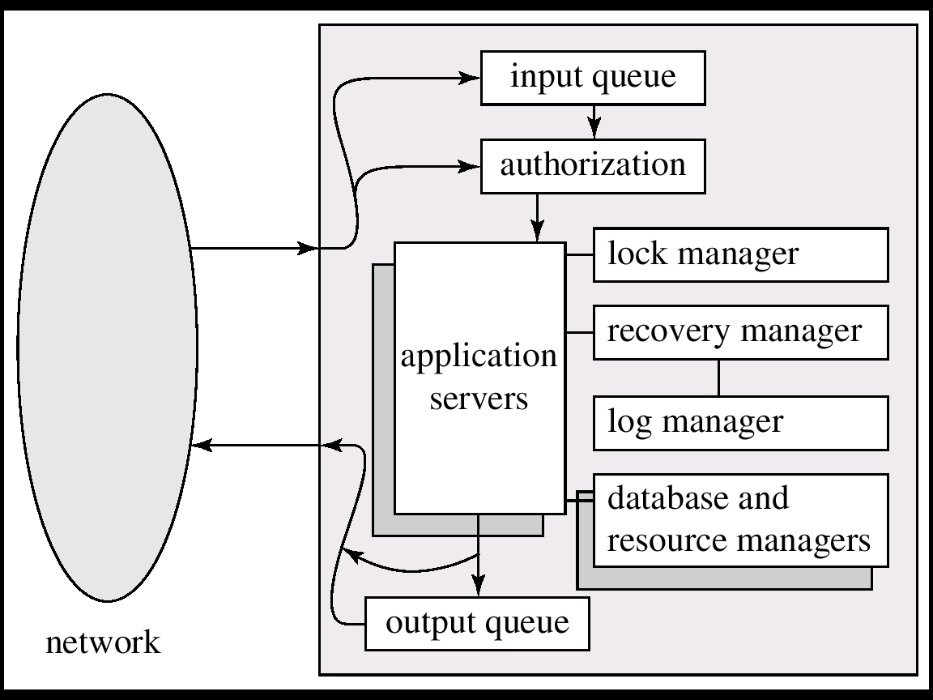
Detailed Structure of a TP Monitor

Slide 7
Detailed Structure of a TP Monitor
Queue manager handles incoming messages
Some queue managers provide persistent or durable message queueing contents of queue are safe even if systems fails.
Durable queueing of outgoing messages is important
  application server writes message to durable queue as part of a transaction
  once the transaction commits, the TP monitor guarantees message is eventually delevered, regardless of crashes.
  ACID properties are thus provided even for messages sent outside the database
Many TP monitors provide locking, logging and recovery services, to enable application servers to implement ACID properties by themselves.

Slide 8
Application Coordination Using TP Monitors
A TP monitor treats each subsystem as a resource manager that provides transactional access to some set of resources.
The interface between the TP monitor and the resource manager is defined by a set of transaction primitives
The resource manager interface is defined by the X/Open Distributed Transaction Processing standard.
TP monitor systems provide a transactional remote procedure call (transactional RPC) interface to their service
  Transactional RPC provides calls to enclose a series of RPC calls within a transaction.
  Updates performed by an RPC are carried out within the scope of the transaction, and can be rolled back if there is any failure.

Slide 9
Workflow Systems

Slide 10
Transactional Workflows
Workflows are activities that involve the coordinated execution of multiple tasks performed by different processing entities.
With the growth of networks, and the existence of multiple autonomous database systems, workflows provide a convenient way of carrying out tasks that involve multiple systems.
Example of a workflow delivery of an email message, which goes through several mails systems to reach destination.
  Each mailer performs a tasks: forwarding of the mail to the next mailer.
  If a mailer cannot deliver mail, failure must be handled semantically (delivery failure message).
Workflows usually involve humans: e.g. loan processing, or purchase order processing.

Slide 11
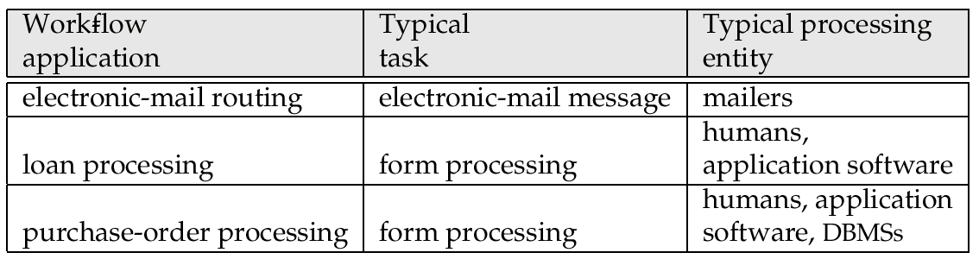
Examples of Workflows

Slide 12
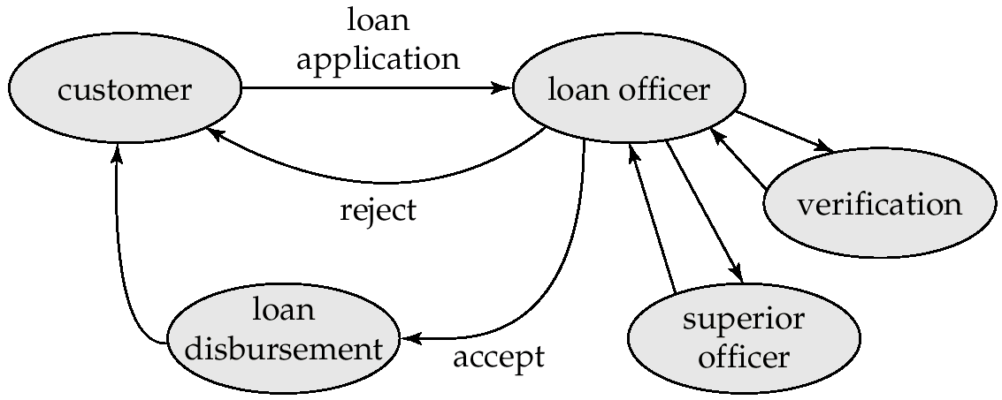
Loan Processing Workflow
In the past, workflows were handled by creating and forwarding paper forms
Computerized workflows aim to automate many of the tasks. But the humans still play role e.g. in approving loans.

Slide 13
Transactional Workflows
Must address following issues to computerize a workflow.
  Specification of workflows - detailing the tasks that must be carried out and defining the execution requirements.
  Execution of workflows - execute transactions specified in the workflow while also providing traditional database safeguards related to the correctness of computations, data integrity, and durability.
  E.g.: Loan application should not get lost even if system fails.
Extend transaction concepts to the context of workflows.
State of a workflow - consists of the collection of states of its constituent tasks, and the states (i.e. values) of all variables in the execution plan.

Slide 14
Workflow Specification
Static specification of task coordination:
  Tasks and dependencies among them are defined before the execution of the workflow starts.
  Can establish preconditions for execution of each task: tasks are executed only when their preconditions are satisfied.
  Defined preconditions through dependencies:
    Execution states of other tasks.
“task t_{i} cannot start until task t_{j} has ended”
    Output values of other tasks.
  “task t_{i} can start if task t_{j} returns a value greater than 25”
    External variables, that are modified by external events.
“task t_{i} must be started within 24 hours of the completion of task t_{j}”

Slide 15
Workflow Specification (Cont.)
Dynamic task coordination
E.g. Electronic mail routing system in which the text to be schedule for a given mail message depends on the destination address and on which intermediate routers are functioning.

Slide 16
Failure-Automicity Requirements
Usual ACID transactional requirements are too strong/unimplementable for workflow applications.
However, workflows must satisfy some limited transactional properties that guarantee a process is not left in an inconsistent state.
Acceptable termination states - every execution of a workflow will terminate in a state that satisfies the failure-atomicity requirements defined by the designer.
  Committed - objectives of a workflow have been achieved.
  Aborted - valid termination state in which a workflow has failed to achieve its objectives.
A workflow must reach an acceptable termination state even in the presence of system failures.

Slide 17
Execution of Workflows
Workflow management systems include:
Scheduler - program that process workflows by submitting various tasks for execution, monitoring various events, and evaluation conditions related to intertask dependencies
Task agents - control the execution of a task by a processing entity.
Mechanism to query to state of the workflow system.

Slide 18
Workflow Management System Architectures
Centralized - a single scheduler schedules the tasks for all concurrently executing workflows.
  used in workflow systems where the data is stored in a central database.
  easier to keep track of the state of a workflow.
Partially distributed - has one (instance of a ) scheduler for each workflow.
Fully distributed - has no scheduler, but the task agents coordinate their execution by communicating with each other to satisfy task dependencies and other workflow execution requirements.
  used in simplest workflow execution systems
  based on electronic mail

Slide 19
Workflow Scheduler
Ideally scheduler should execute a workflow only after ensuring that it will terminate in an acceptable state.
Consider a workflow consisting of two tasks S₁ and S₂. Let the failure-atomicity requirement be that either both or neither of the subtransactions should be committed.
  Suppose systems executing S₁ and S₂ do not provide prepared-to-commit states and S₁ or S₂ do not have compensating transactions.
  It is then possible to reach a state where one subtransaction is committed and the other aborted. Both cannot then be brought to the same state.
  Workflow specification is unsafe, and should be rejected.
Determination of safety by the scheduler is not possible in general, and is usually left to the designer of the workflow.

Slide 20
Recovery of a Workflow
Ensure that is a failure occurs in any of the workflow-processing components, the workflow eventually reaches an acceptable termination state.
Failure-recovery routines need to restore the state information of the scheduler at the time of failure, including the information about the execution states of each task. Log status information on stable storage.
Handoff of tasks between agents should occur exactly once in spite of failure.
Problem: Repeating handoff on recovery may lead to duplicate execution of task; not repeating handoff may lead to task not being executed.
  Solution: Persistent messaging systems

Slide 21
Recovery of a Workflow (Cont.)
Persistent messages: messages are stored in permanent message queue and therefore not lost in case of failure.
  Described in detail in Chapter 19 (Distributed Databases)
Before an agent commits, it writes to the persistent message queue whatever messages need to be sent out.
The persistent message system must make sure the messages get delivered eventually if and only if the transaction commits.
The message system needs to resend a message when the site recovers, if the message is not known to have reached its destination.
Messages must be logged in stable storage at the receiving end to detect multiple receipts of a message.

